Slide 1
SIT113 Cloud Computing and Virtualisation
Week 1, Class 2
Cloud Introduction

Slide 2
Outline
Cloud Infrastructure
Popularity
Why Use Clouds?
Public Clouds and Services
Essential Characteristics of Clouds
Benefits and Risks
Datacentres, Clusters, Hosts, Hypervisors, VMs
Templates, Datastores and Pods
NetLab+ VE Demonstration

Slide 3
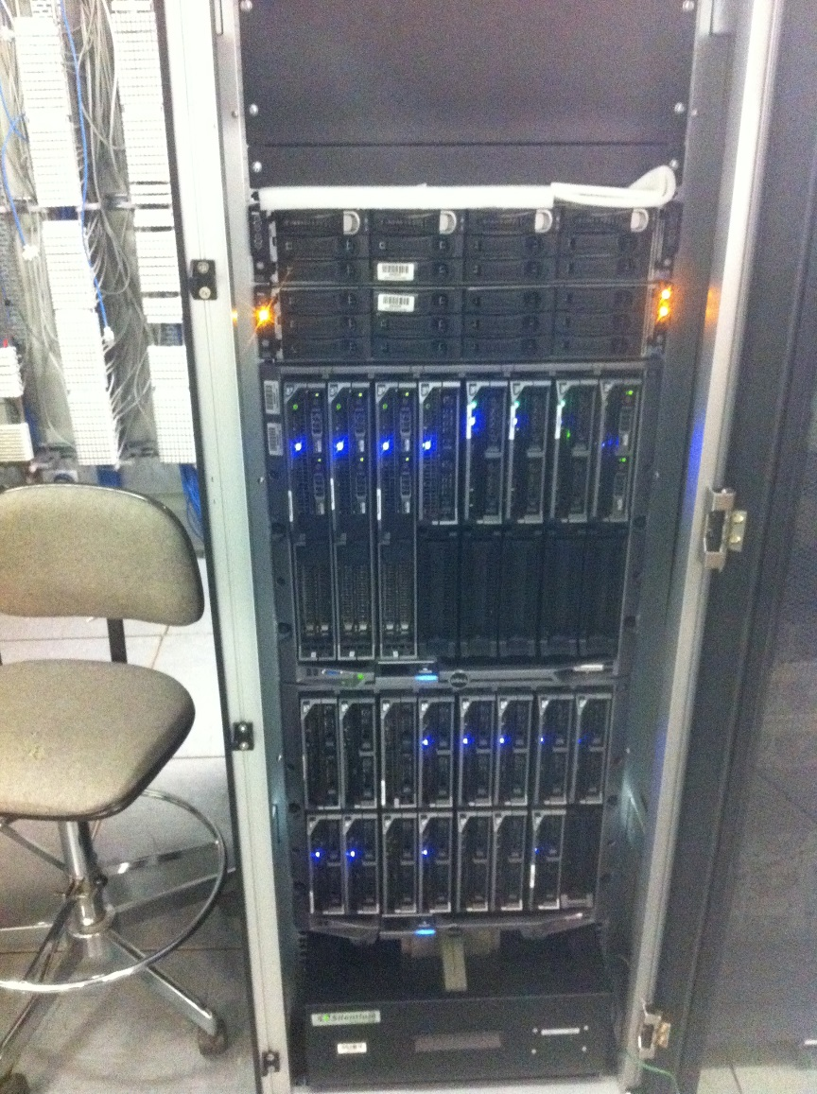
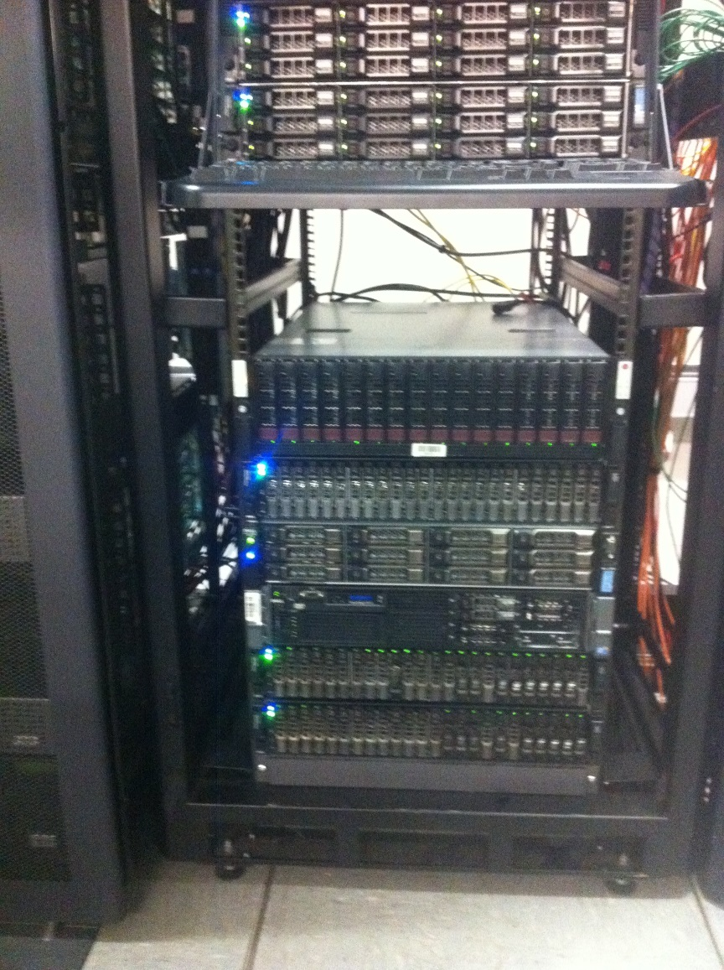
Cloud Infrastructure
xxx
Computation
NAS

Slide 4
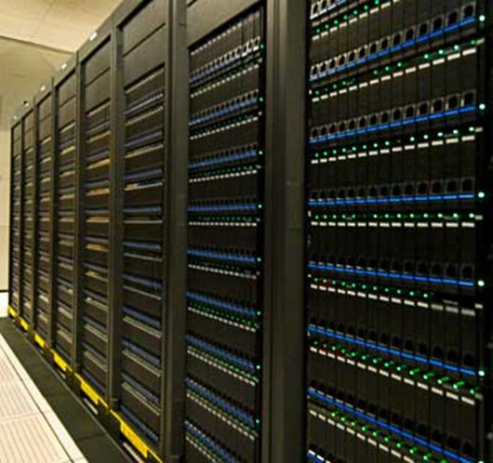
Cloud Infrastructure

Slide 5
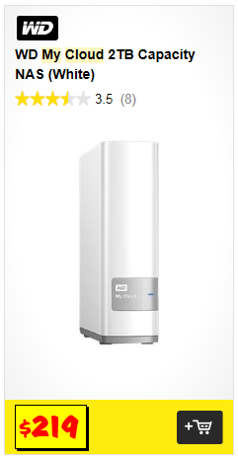
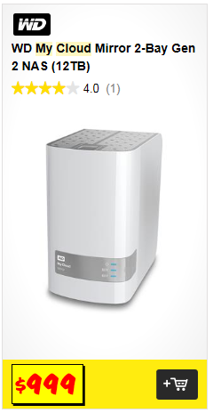
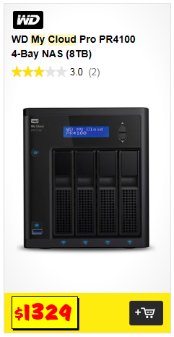
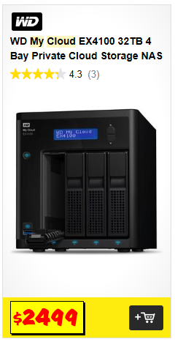
Popularity (JB HIFI 2017)
xxx

Slide 6
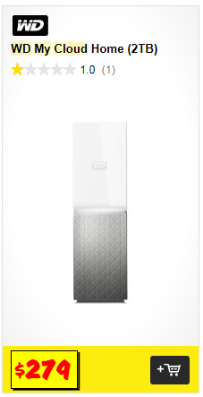
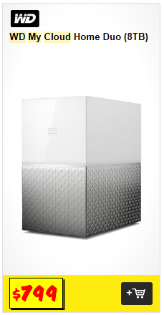
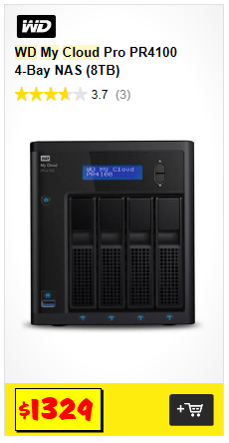
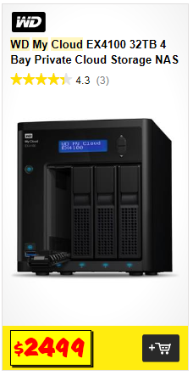
Popularity (JB HIFI 2018)
xxx

Slide 7
Why Use Clouds?
File Storage
Backup
Disaster Recovery
Big Data Analytics
Test and Development
Infrastructure as a Service (IaaS)
Platform as a Service (PaaS)
Software as a Service (SaaS)

Slide 8
Public Clouds and Services
Microsoft Azure http://azure.microsoft.com
AWS http://aws.amazon.com
Google Cloud http://cloud.google.com
Oracle Cloud https://cloud.oracle.com
SalesForce http://www.salesforce.com/au
IBM Cloud http://www.ibm.com/cloud-computing/au/en
Storage Services
Database Services
Other Services
Computational Services
Network Services

Slide 9
Essential Characteristics of Clouds
On-demand Self-service
Broad Network Access
Resource Pooling
Rapid Elasticity
Measured Service

Slide 10
Benefits
Reduce up-front IT investments
On-demand, short term access to IT resources
Perception of unlimited IT resources
Add/Remove IT resources at a fine-grained level
Elasticity
Increased availability
Increased reliability

Slide 11
Risks
Operational Control
IT resources are off-premise, not on-premise
Security
Data security is shared with cloud provider
Trust
Cloud provider might be untrustworthy
Responsibility
Cloud consumer is ultimately responsible for security, integrity, and storage of their own data

Slide 12
Risks
Compatibility
Can we move from one provider to another?
Geographic Location
Large distances may decrease performance
Different laws in different countries

Slide 13
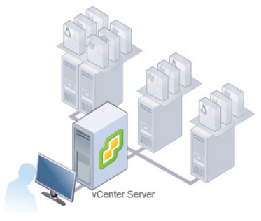
vCenter Servers, Datacentres, Clusters, Hosts, Hypervisors, VMs
vCenter Server is used to manage datacentres, clusters, hosts, VMs; allowing you to automate and deliver virtual infrastructures.

Slide 14
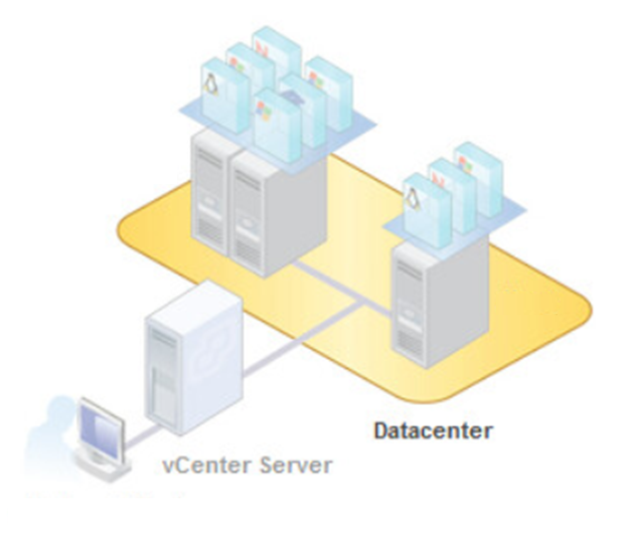
vCenter Servers, Datacentres, Clusters, Hosts, Hypervisors, VMs
A datacentre is a container of IT resources such as clusters, hosts, VMs and folders.

Slide 15
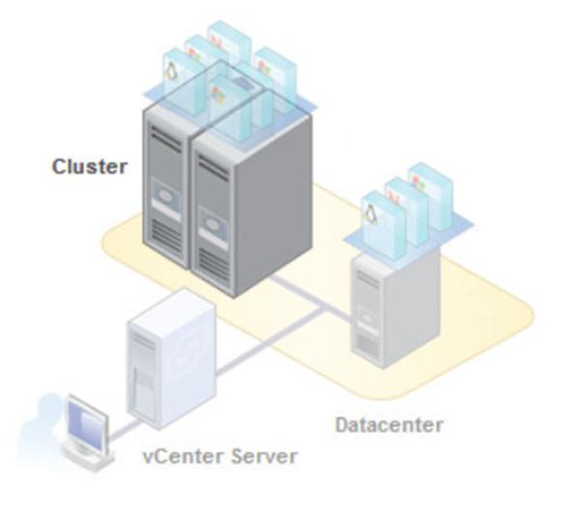
vCenter Servers, Datacentres, Clusters, Hosts, Hypervisors, VMs
A cluster is a group of hosts that share IT resources, and a management interface. A host’s resources are included within the cluster’s resources.

Slide 16
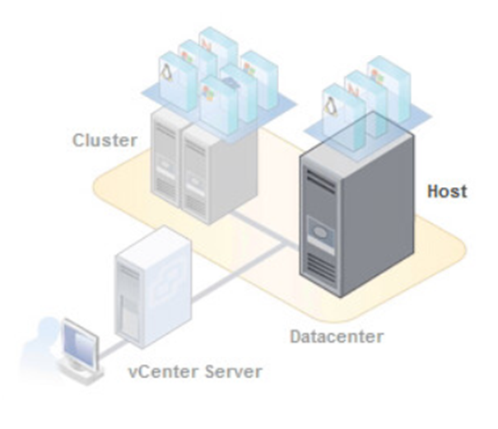
vCenter Servers, Datacentres, Clusters, Hosts, Hypervisors, VMs
A host is a computer running virtualisation software (hypervisor such as ESXi) to manage multiple VMs.

Slide 17
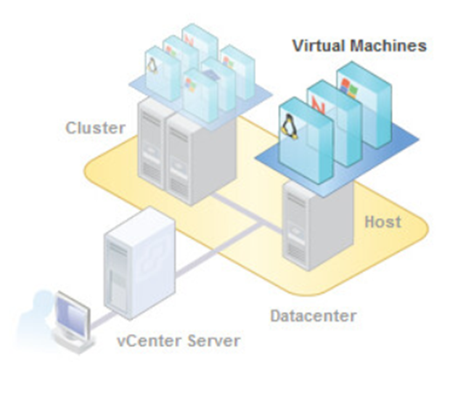
vCenter Servers, Datacentres, Clusters, Hosts, Hypervisors, VMs
A VM is a software computer that runs an operating system and processes.

Slide 18
Templates and Datastores
A template is an image of a VM that can be used to create other VMs.
A datastore is a logical container of VM files and other files for operating VMs.

Slide 19
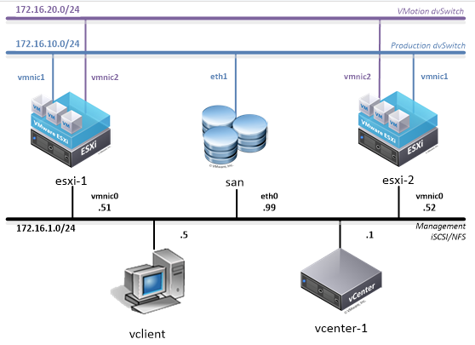
POD
A POD is a set of building blocks of hardware and software to support a particular role.

Slide 20
NetLab+ VE Demonstration
This demonstration includes:
Logging in to NetLab+ VE
https://vmlab.it.deakin.edu.au
Reserving a Pod to participate in a Lab
Logging in to the vSphere Web Client
Accessing IT resources using the vSphere Web Client

Slide 21
Summary
Cloud Infrastructure
Popularity
Why Use Clouds?
Public Clouds and Services
Essential Characteristics of Clouds
Benefits and Risks
Datacentres, Clusters, Hosts, Hypervisors, VMs
Templates, Datastores and Pods
NetLab+ VE Demonstration

